Slide 1
Using PowerPoint to Create Simple “Explainer Videos”
Jared McBrady
History Department
Notes:
I teach in our social studies education program, preparing future history teachers. Last semester was an abrupt, haphazard conversion to online learning for me (and I’m sure for many of you as well). I didn’t want a repeat of that this semester. So over the summer, I thought about approaching the online elements of my course deliberately, because I wanted them to, as best I could, enhance my teaching and maintain student learning. And one of the ways I decided to do that was through explainer videos.

Slide 2

What are Explainer Videos?
Notes:
So what are explainer videos?

Slide 3







Notes:
If you’ve spent any time online, you are likely to have encountered them. They are short, energetic videos designed to explain a concept or a product. They are often animated using simple graphics; animated in the style of whiteboard drawings, for example, was a popular choice for many videos. Explainer videos have really dominated the Business-to-Business advertising market, as businesses use them as an effective way to explain their product or service [and attribute increased revenue to their use of explainer videos]. But explainer videos are spreading to other areas as well, including education. In fact, when I worked with the Big History Project, a high school world history curriculum developed at the University of Michigan, explainer videos became a central part of the curriculum.

Slide 4
Focus
Length
Storytelling
Script
Visuals
Source: Duy Linh Tu, Feature and Narrative Storytelling for Multimedia Journalists (Burlington, MA: Focal Press, 2015). Cited in Andreas Krämer & Sandra Böhrs, “How Do Customers Evaluate Explainer Videos? An Empirical Study on the Effectiveness and Efficiency of Different Explainer Video Formats,” Journal of Education and Learning 6, no. 1 (2017): 254-266.
Notes:
Tu (2015) identifies five key characteristics of explainer videos.
1. Script: They follow a well-written script that is clear on the main message the video wants to impart.
2. Reduced length: research indicates 1-4 minutes is ideal (I’m not always successful keeping my videos in the ideal length, but I try not to drag them on too long.)
3. Focus: Focus on the core message, starting with the “why” before moving on to the “what,” and the “how.”
4. Storytelling: Explainer videos try to engage with the audience through the use of story. In many of mine, I incorporate stories from my own teaching, or stories from the student teachers I have supervised. These anecdotes often establish the “why” for many of my videos.
5. Visuals: Good visuals engage, capture the imagination, but also activate multiple senses. This multi-modal activation of audio and visual information helps increase retention. That’s why these explainer videos are often animated.

Slide 5
Why Explainer Videos?
Notes:
So why use explainer videos?

Slide 6
Increased student engagement
Shorter videos
Personal touch
Enthusiastic speaker
Interspersed lecture and slides
Animated
Source: Philip J. Guo, Juho Kim, & Rob Rubin, “How Video Affects Student Engagement: An Empirical Study of MOOC Videos” (paper presented at the Learning at Scale Conference, Atlanta, Georgia March 4-5, 2014) http://dx.doi.org/10.1145/2556325.256639/.
Notes:
They increase engagement and learning over other video types. My results, of course, are only preliminary and purely anecdotal. But in comparing my video lectures from last semester to my explainer videos this year, I have observed that more students are actually watching them (and actually watching the whole thing). Students have responded positively as well, saying they much prefer this style. There seems to be increased retention of material, although I haven’t formally measured that.
Looking at more empirical data than my anecdotes, Guo, Kim, & Rubin (2014) analyzed over 6.9 million video watching sessions from online courses. They found increased engagement (as measured by the length of time spent on the video and students attempting follow-up assessment afterwards) in videos that exhibited the following characteristics:
Shorter videos are more engaging than longer videos.
Videos which show instructors speaking quickly and with enthusiasm, are more engaging.
Animated tablet drawing tutorials (like Khan Academy) are more engaging than static PowerPoint slides.
Videos with a personal touch more engaging than high-quality studio recordings.
Videos that intersperse an instructor’s talking head with slides are better than slides alone.

Slide 7




Making an Explainer Video
Notes:
Once I decided to work with explainer videos over the summer, this started my search for an easy to use, flexible, inexpensive tool for creating these videos. When I worked with the Big History Project, of course, we were flush with Gates money and just hired out the task of producing videos. Not so now!
So I tried a lot of things. I looked at our Adobe suite, which SUNY Cortland subscribes to. Adobe Spark was way too limited – it lacked the functionality I needed. But the other Adobe products (Animate or Premier Pro) were way to complex. There were a whole slew of other applications for making explainer videos: Animaker, Powtoons, Vyond, Animoto. All had similar problems. Free versions were too limited (and kept their own watermark on the final product). Paid versions were too expensive.
And then I discovered that a tool I was already very familiar with – PowerPoint – allowed you to record and export presentations as videos. So that became my software of choice. Now maybe many of you were already familiar with these capabilities in PowerPoint, but to me it was quite the revelation.
So next I am just going to talk through my design process as I create an Explainer Video using PowerPoint.

Slide 8
Monday
Wednesday
Direct Instruction
Direct Instruction
Interactive Learning
Interactive Learning
Direct Instruction
Direct Instruction
Independent Work
Independent Work
Direct Instruction
Direct Instruction
Group Discussion
Group Discussion
Whole Class Discussion
Whole Class Discussion
Notes:
The first thing that happens is the script – at least a rough draft. I was teaching a hybrid course this year, so more than half of my content had to move online. I revisited my own class plans, reviewed my lectures and activities, and thought deliberately about breaking it down into smaller sections. If I wanted to cut up my 75 minute class into chunks of ten minutes or less, where did that make sense?

Slide 9
Online
In Person
Direct Instruction
Whole Class Discussion
Direct Instruction
Interactive Learning
Direct Instruction
Group Discussion
Independent Work
Independent Work
Direct Instruction
Interactive Learning
Direct Instruction
Group Discussion
Direct Instruction
Whole Class Discussion
Notes:
With that, I started to identify pieces of my lesson that I could chunk into a short video. I then roughed out the script of what my video would contain. Then, I took to PowerPoint to make my slides. I focused on three elements in designing the slides.

Slide 10

Instructional Routines
Personal Relationships
Good Lesson Planning
Notes:
First: Visuals. Visually, I wanted a clean look that balanced limited texts with clean graphics that reinforce the audio. So this is an image of a three legged stool – a metaphor I use when teaching the concept of good classroom management.
(I make my own graphics using Inkscape, a free vector graphic software, but there are many free images available over the internet. FreePik.com is one such resource.

Slide 11
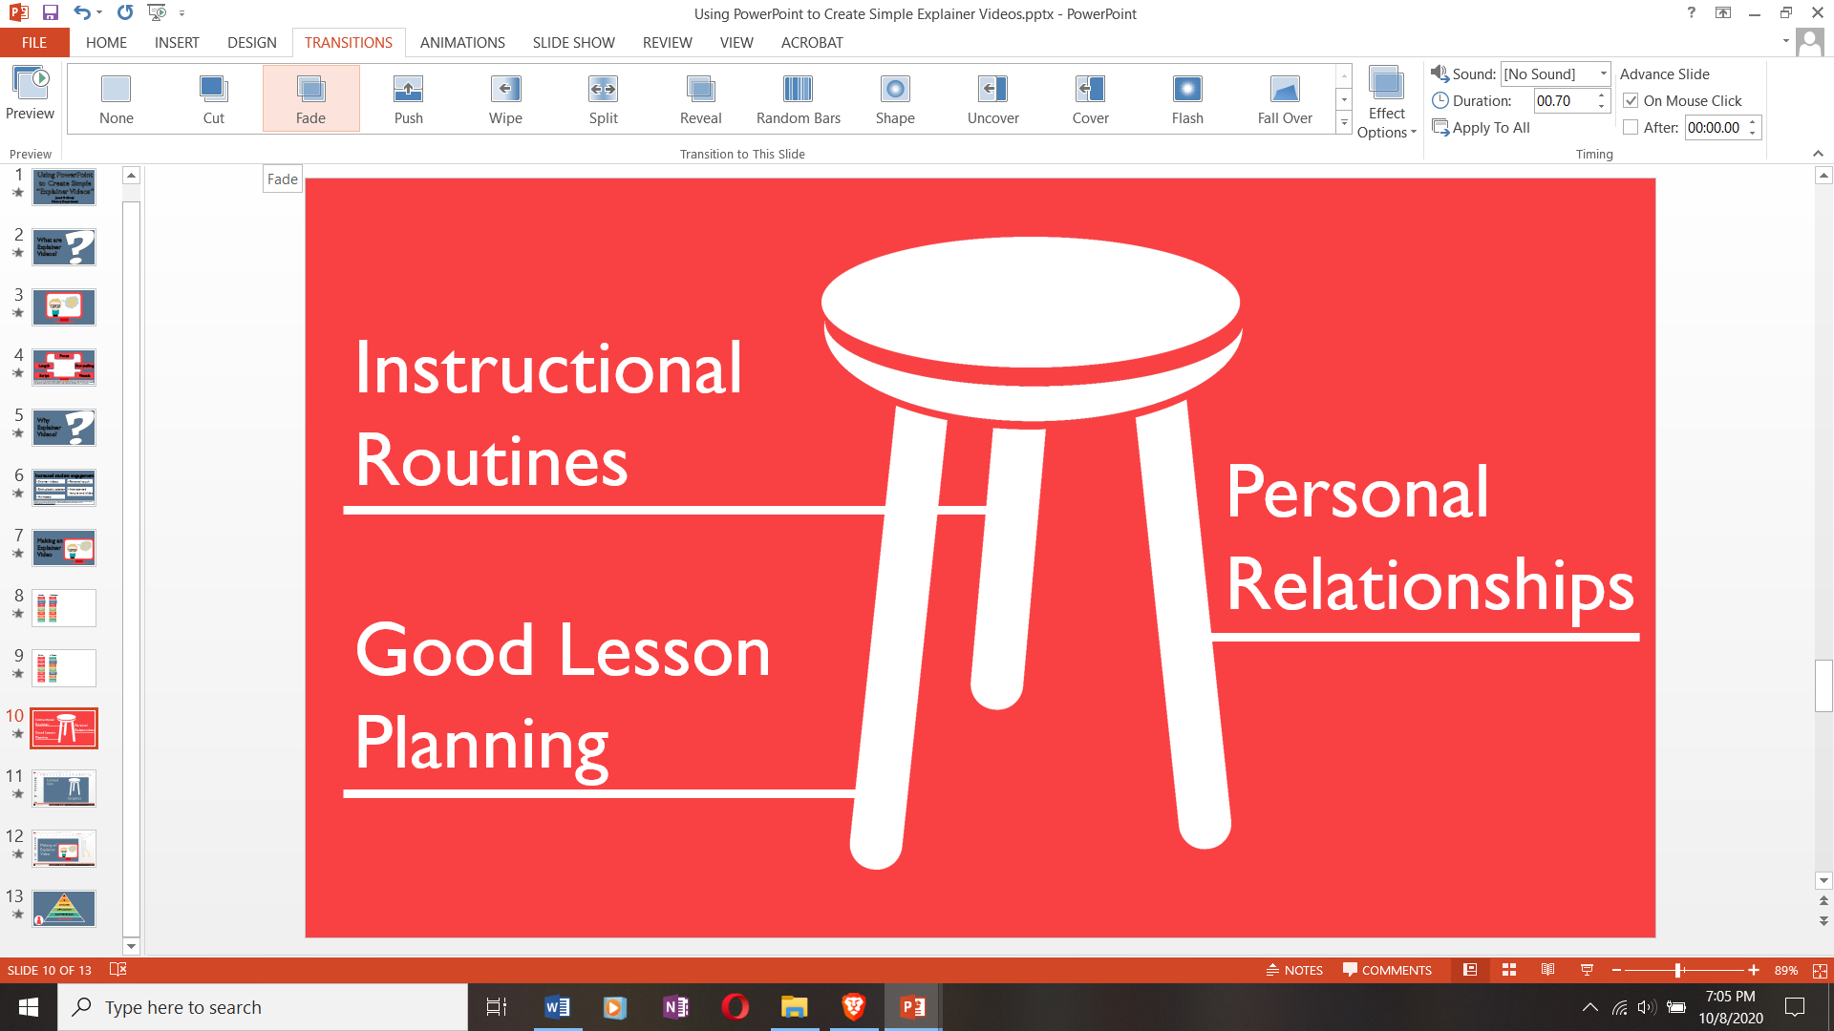
Notes:
Second, Transitions. To smooth out transitions between one slide and the next, I choose the “Fade” option under the Transitions tab.

Slide 12
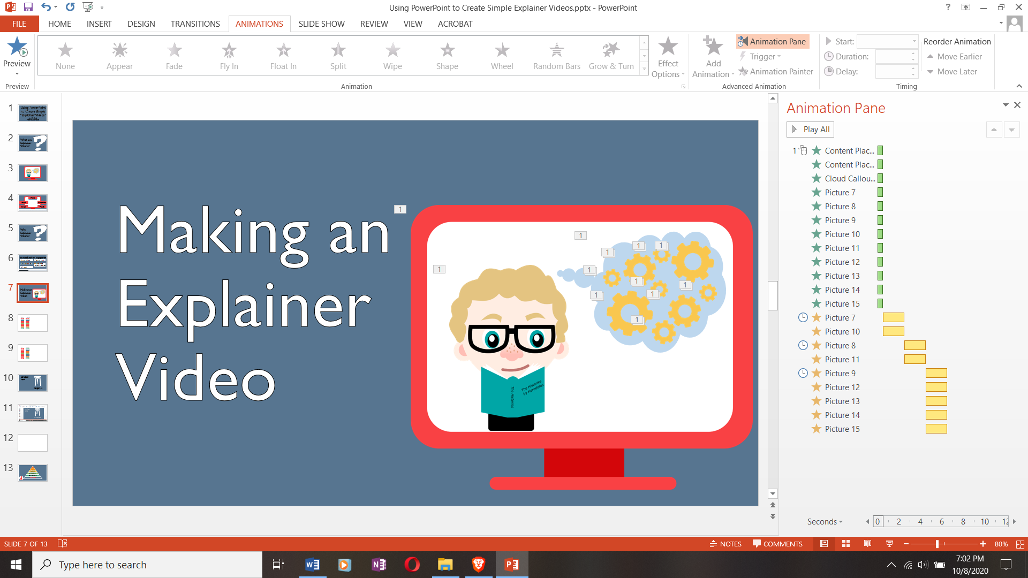
Notes:
Third: Animations. I want to create movement and animation in my PowerPoint, so it isn’t just a static slide. There are many different options for animations built into the Animation tab of PowerPoint, and clicking on the Animation Pane makes it easy to see which elements have animations, and the order in which those animations take place. I want to share my top three animations that I use.

Slide 13
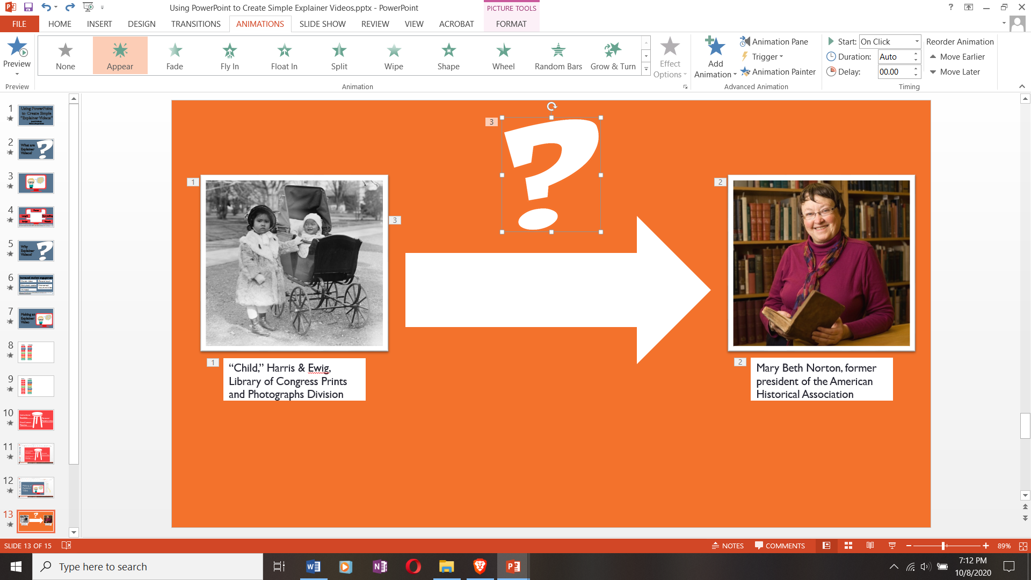
Notes:
Appear lets me control when texts or graphics appear – meaning I can time them to show up when I speak about them.

Slide 14

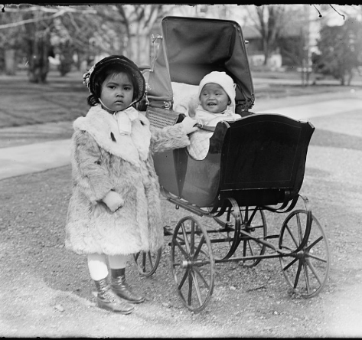

“Child,” Harris & Ewig, Library of Congress Prints and Photographs Division
Mary Beth Norton, former president of the American Historical Association
Notes:
So you can see here, as I lecture about research into the thought of children, the thought of experts, and the learning progression models that describe the middle between these two, I can make each of those elements appear when I want to talk about them. You can also make them go away with “Disappear.”

Slide 15
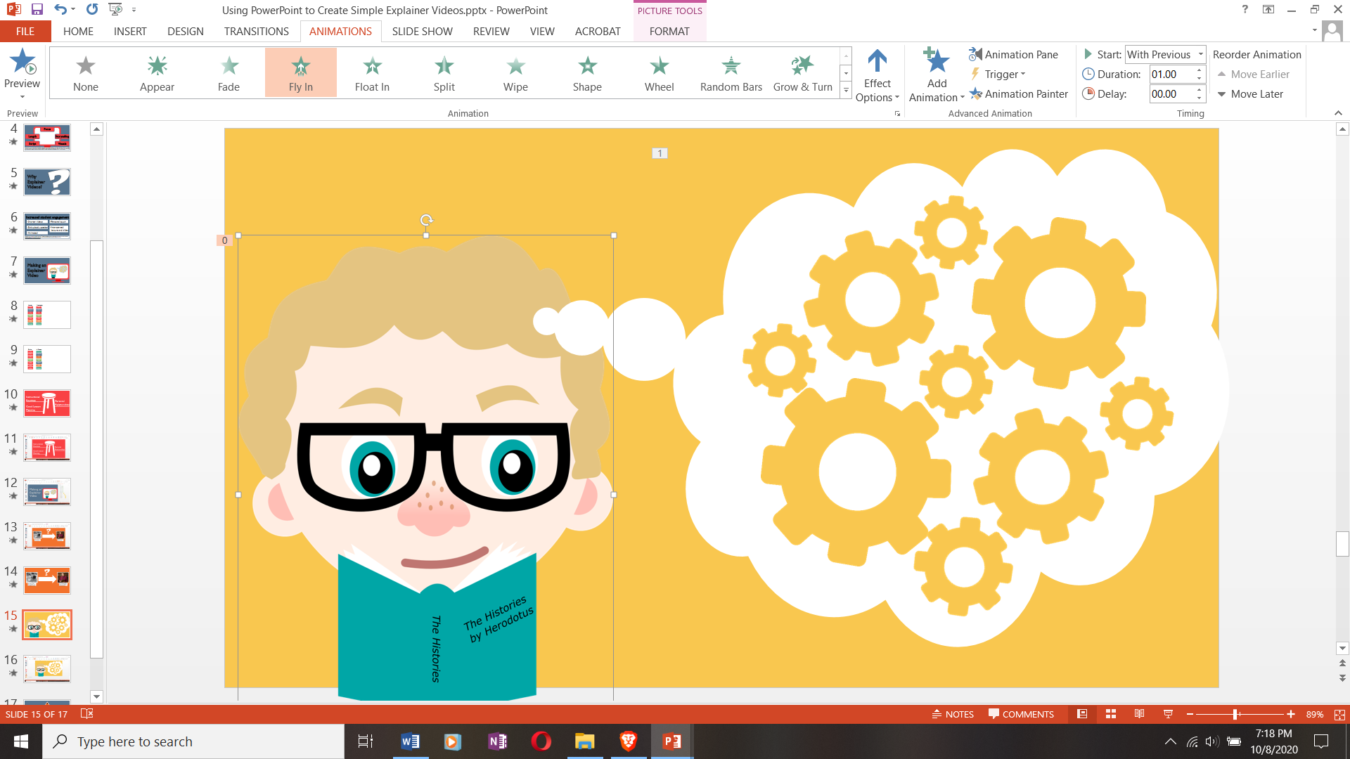
Notes:
“Fly In” lets elements come in from off-screen: adding movement and drawing attention to them. I will often use this to “build” a scene.

Slide 16





Slide 17
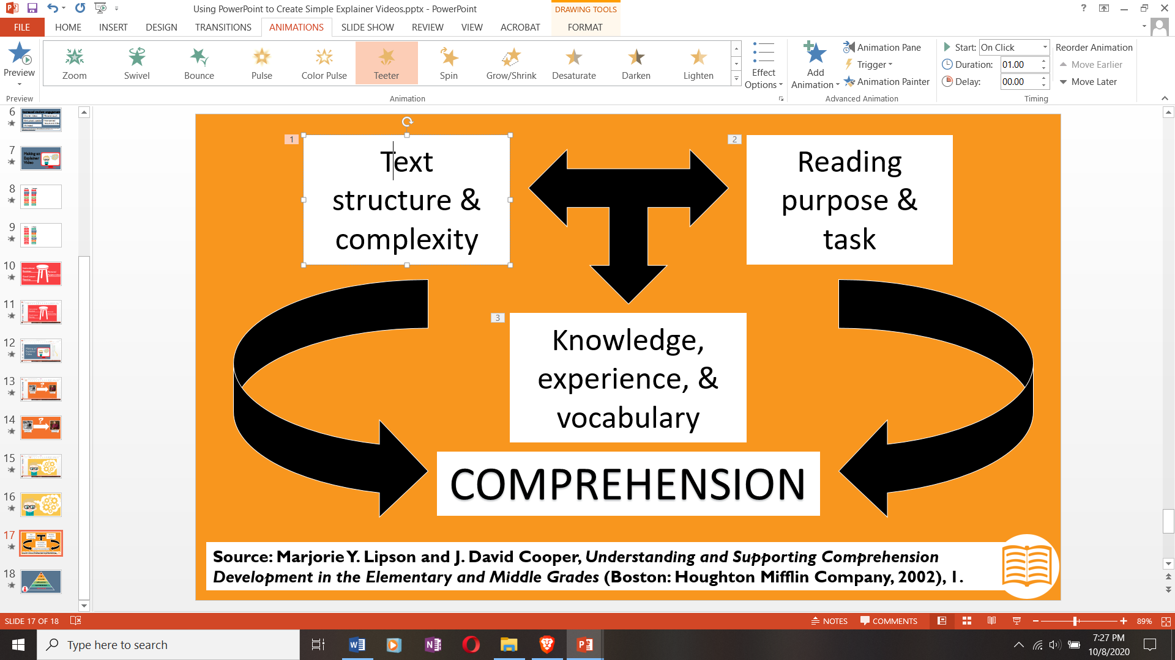
Notes:
“Teeter” is one of my preferred ways to add movement to an element. I frequently use that to call attention to something that is already on-screen.

Slide 18

Text
structure & complexity
Reading
purpose & task
Knowledge, experience, & vocabulary
COMPREHENSION
Source: Marjorie Y. Lipson and J. David Cooper, Understanding and Supporting Comprehension Development in the Elementary and Middle Grades (Boston: Houghton Mifflin Company, 2002), 1.
Notes:
So when I want to point out a specific element of a diagram while I am talking about it, for example, I use teeter. Pulse and spin are other good options for calling attention to otherwise static elements.

Slide 19
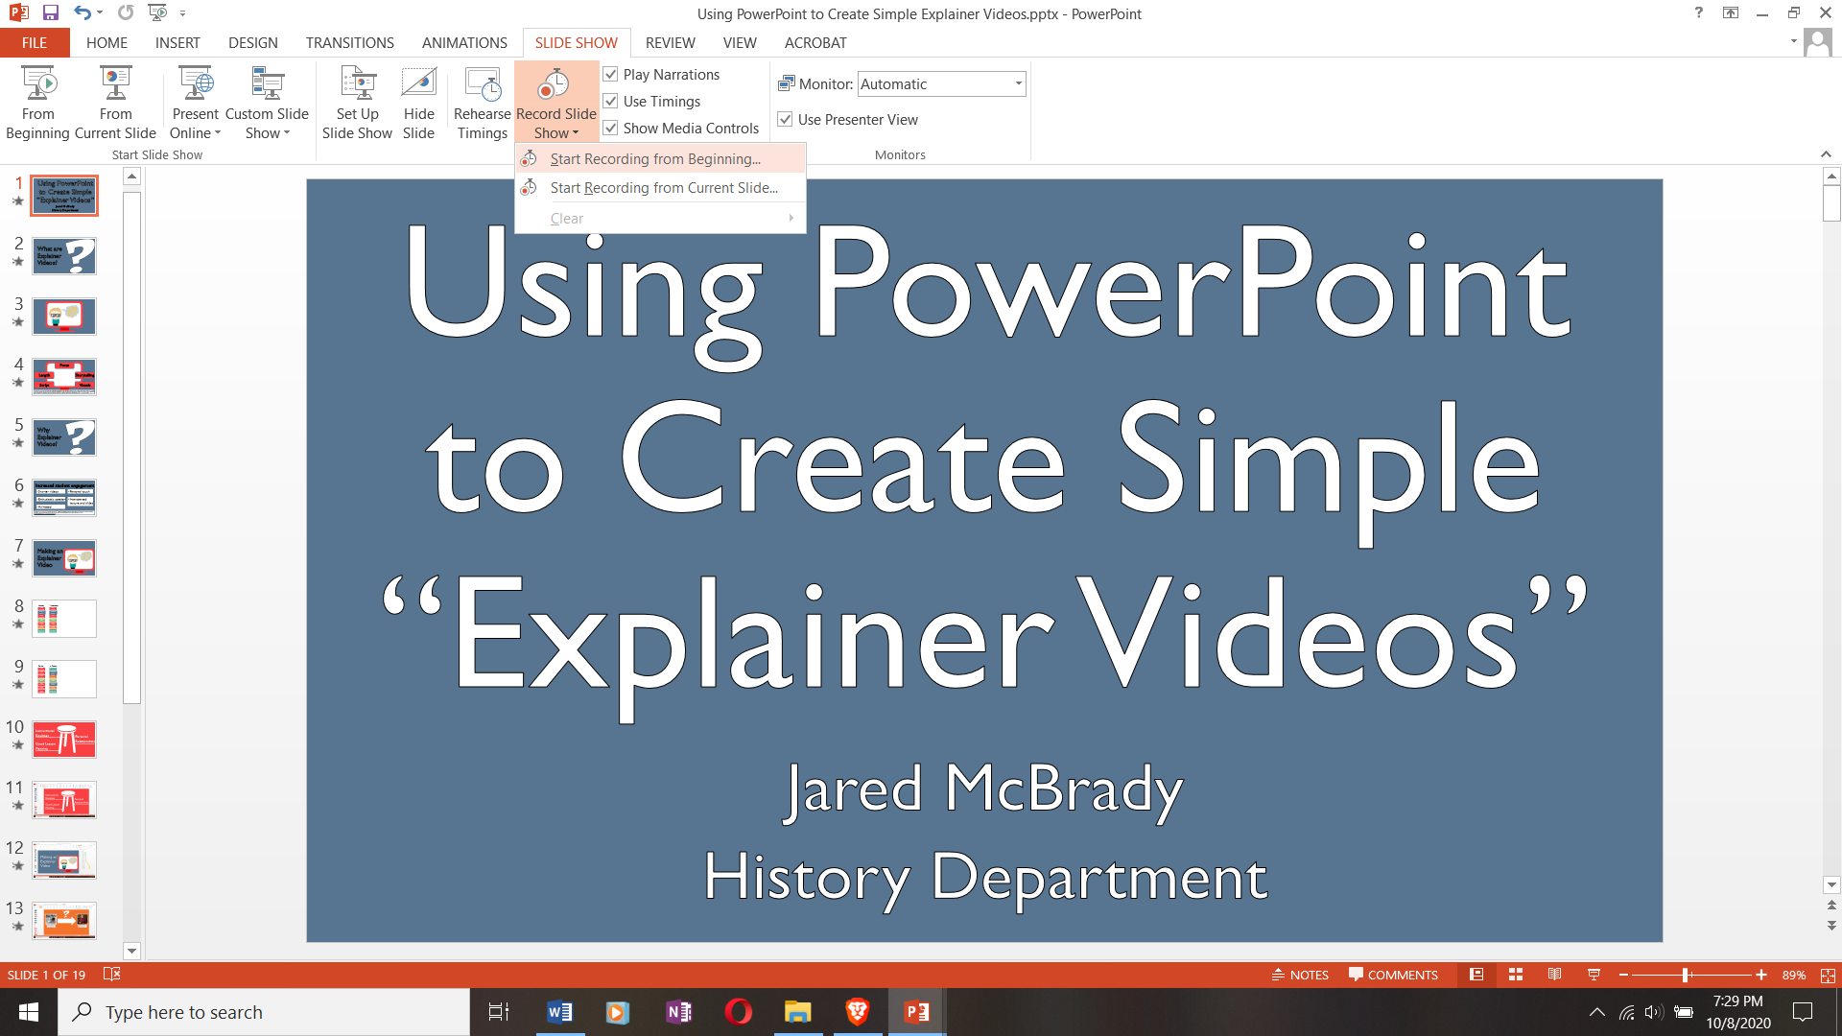
Notes:
Once I have finished my script and PowerPoint slides, it is time to record the presentation.
This happens through hitting the Slideshow tab and choosing Recording Slide show. This records not only the timings on each of your slides, but also your narration over them.

Slide 20
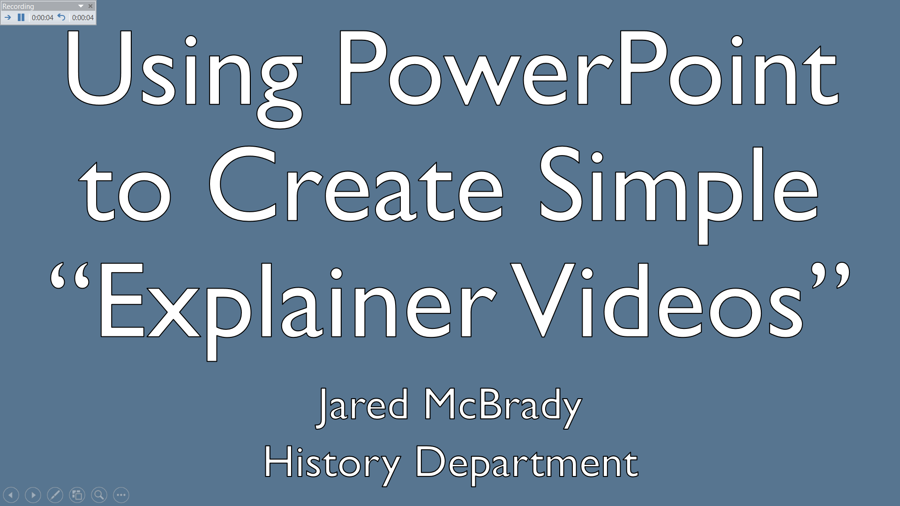
Notes:
You can advance through and record the whole PowerPoint presentation at once. You can also hit this arrow to “restart” a recording on a slide. You can pause and resume narration. And you can advance to the next animation or next slide using this button (or just clicking the mouse or keyboard arrow). Any time you want to quit recording, just hit the ESC key. This is important, because if you want to go back and just change one slide, you can record over and then ESC before leaving that slide. If you click ahead, you’ll start recording over other slides. I made that mistake early on, and lost all my previous recordings on the other slides.

Slide 21
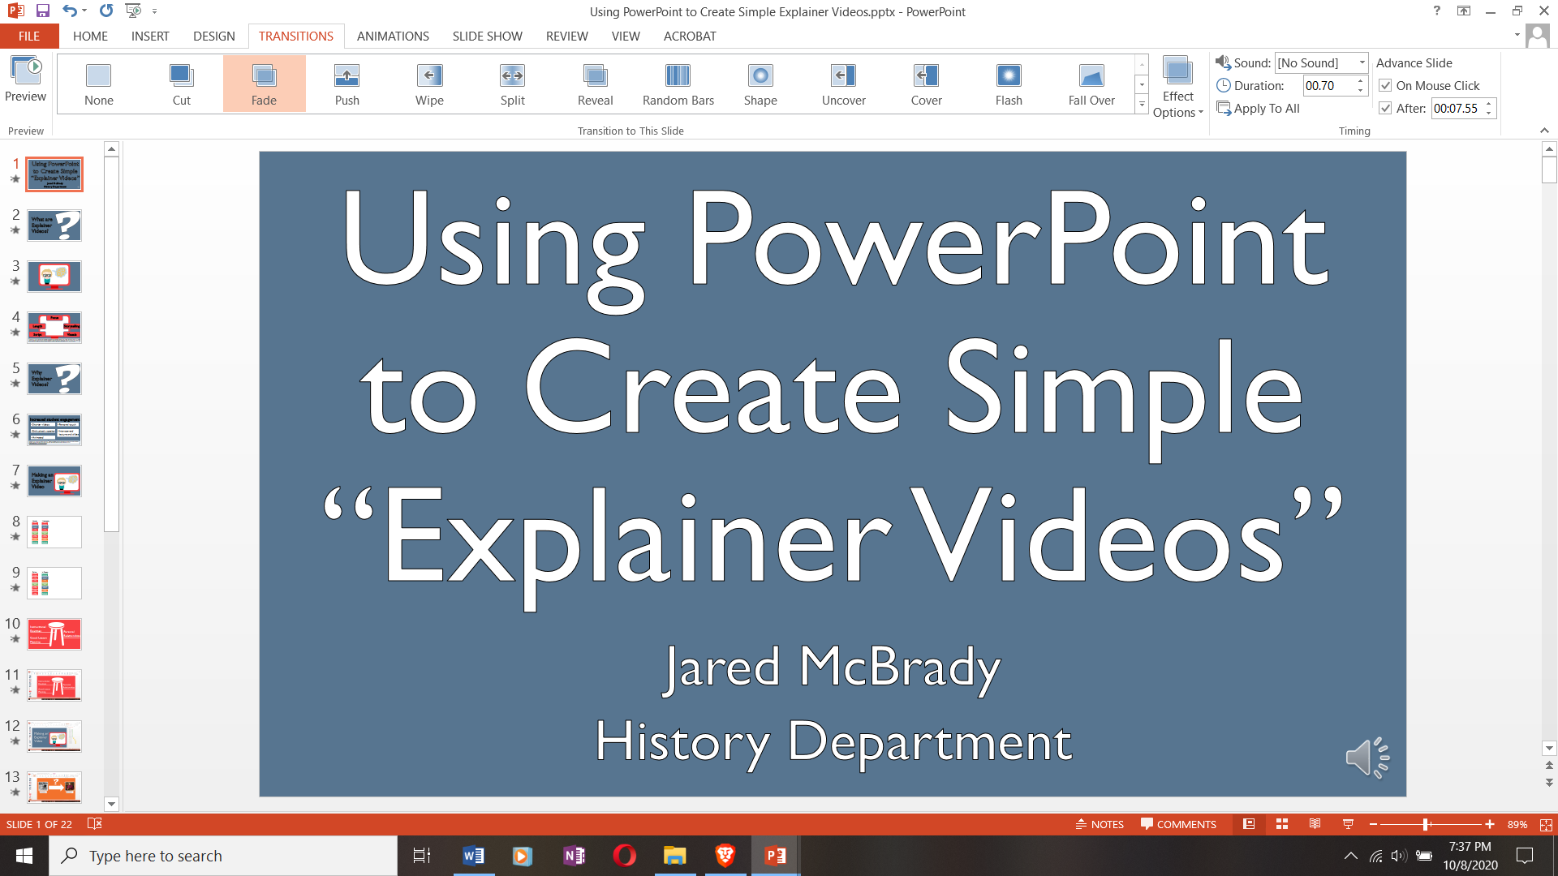
Notes:
Once you’ve finished recording, you should be able to see the narration for the slide and the timing for the slide to advance in the PowerPoint editing pane.

Slide 22
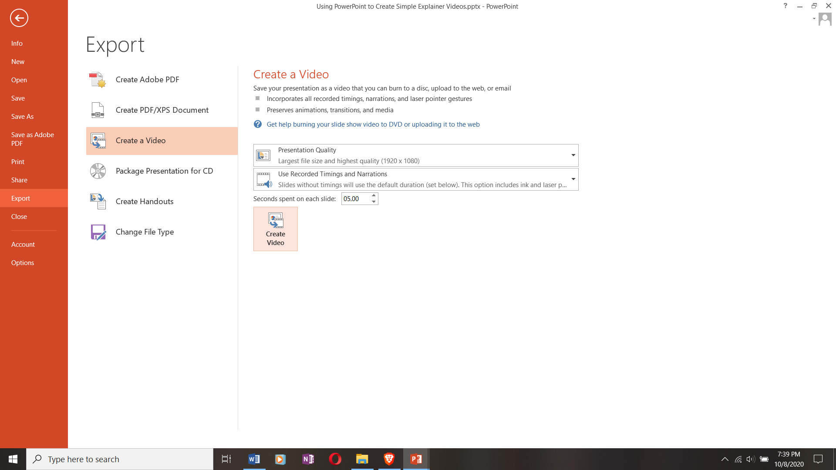
Notes:
Finally, once I’ve recorded my timing and narration for the whole presentation, I need to export it as a video file. So, I click “File,” and then go down to “Export,” and then select “Create a Video.” This exports an .MP4 file. Once I have that I can do whatever I want with the video file. I prefer to upload video files into Ensemble, SUNY Cortland’s video hosting platform. In Ensemble, I can add in closed captions (easy to do if I’ve already typed out my script). I can embed multiple choice questions into the video (like edPuzzle), and I can embed the video directly into my Blackboard page.

Slide 23
Using Explainer Videos
Notes:
So how have I been using these videos?
-Flipped classroom: explaining a concept/theory/practice of education that we then apply in class
-Breaking up lectures into smaller chunks
-Reading introductions
-Having my students produce their own videos, to explain a person/place/thing from the social studies curriculum.
-A permanent, reviewable reference to key concepts in traditional f2f classes.

Slide 24
Notes:
And now I’m happy to open up discussion to your own ideas for using these videos, or other comments or questions.

Slide 25

Resources
FreePik, “Graphic Resources for Everyone.” Accessed October 8, 2020. https://www.freepik.com/.
“Looking Sleek with Smooth PowerPoint Transitions,” BrightCarbon Blog, May 21, 2015, https://www.brightcarbon.com/blog/looking-sleek-with-smooth-powerpoint-transitions/.

Slide 26
Citations
Guo, Philip J., Juho Kim, & Rob Rubin. “How Video Affects Student Engagement: An Empirical Study of MOOC Videos.” Paper presented at the Learning at Scale Conference, Atlanta, Georgia March 4-5, 2014. http://dx.doi.org/10.1145/2556325.256639/.
Krämer, Andreas & Sandra Böhrs. “How Do Customers Evaluate Explainer Videos? An Empirical Study on the Effectiveness and Efficiency of Different Explainer Video Formats.” Journal of Education and Learning 6, no. 1 (2017): 254-266.
Laaser, Wolfram and Eduardo A. Toloza. “The Changing Role of the Educational Video in Higher Distance Education.” International Review of Research in Open and Distributed Learning 18, no. 2 (April 2017): 1-13.
Tu, Duy Linh. Feature and Narrative Storytelling for Multimedia Journalists. Burlington, MA: Focal Press, 2015.

