Slide 1
Assessing Students Online
Institute for College Teaching & Design Help Sept. 26, 2019

Slide 2
Comparing Paper Homework to Blackboard
Look at the handout. What conclusions do you draw regarding student views of online homework?
Johnston, T. (2004). Online Homework Assessments: Benefits & Drawbacks to Students. Academy of Educational Leadership Journal, 8(3), 29-40.

Slide 3
Assessments from 60 Online Courses
Method | Courses using this method | Average % of Course Grade
Discussion | 59 | 17.1%
Exam | 50 | 44.7%
Written Assignment | 38 | 23.5%
Final/Midterm | 23 | 19.2%
Experiential Assignment | 20 | 18.1%
Problem Assignment | 19 | 22.0%
Quiz | 13 | 3.5%
Paper | 13 | 23.2%
Journal | 10 | 15.1%
Presentation | 6 | 12.5%
Pretest | 6 | 1.0%
Project | 4 | 12.8%
Peer Review | 3 | 4.6%
Form | 1 | 1.0%
Group Project | 0
Arend, B. (Feb. 2007). Course Assessment Practices & Student Learning Strategies in Online Courses. Online Learning, 11(4).

Slide 4
Online Quiz Design
Frequent small quizzes rather than infrequent large tests
Assume quizzes are open-book
Limit test-taking time
Use large question pools with small quizzes
Formative assignments should use check/no check grading

Slide 5
Empower Students & Use Efficient Feedback
Begin the course with a module helping students become a self-directed learner.
Build multiple feedback methods into the course.
Label communications to students as "feedback."
Have students practice the skills you want them to learn.
Aim individual feedback at higher cognition.
Aim group feedback at common errors.
Use a positive tone in both individual & group feedback.
Pates, J., Blake, R., & Cooper, A. (2010). Using structured reflection to encourage more active use of feedback. Planet, 23(1), 2-10.

Slide 6
Assessments: Online Assignments
Any easy way to collect assignments, papers, or files from your students
Able to provide feedback
Students receive submission confirmation
Students have easy access to grades
Demonstration in Blackboard

Slide 7
Assessments: Quizzes
Question Sets
Question Pools
Random Blocks

Slide 8
SafeAssign: Online Assignments
User submissions are compared with content from other students at SUNY Cortland, from other schools, from academic and business journals, and from the broader Internet.
Originality Report
Interpreting a Score

Slide 9
SafeAssign: Direct Submit
DirectSubmit generates SafeAssign reports on papers not uploaded to an assignment with the SafeAssign service.
You can use DirectSubmit to add papers to the institutional database.
Submit a single paper or multiple papers via ZIP file.

Slide 10
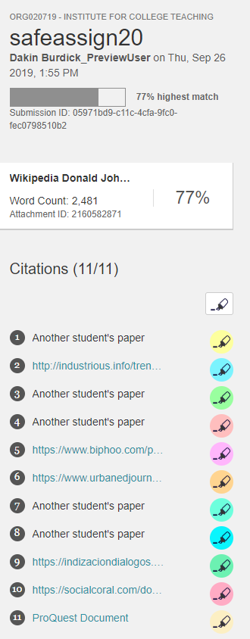
SafeAssign: Student Papers Prioritized
The paper at the left was a straight copy from Wikipedia, but since SafeAssign searches for matches in student papers first, it under-reported the lack of originality.

