Slide 1

Understanding Our Students: Enrollment, Retention and Student Success

Slide 2
Measuring Student Success
What’s measured
improves.
-Drucker
Not everything that counts can be counted and not everything that can be counted counts.
-Einstein

Slide 3
Agenda
Enrollment Update | Mark Yacavone Assistant Vice President for Enrollment Management
Retention, Graduation and Student Experience | Dr. Carol Van Der Karr Associate Provost for Academic Affairs
Intentional Practices | Abby Thomas Director of Advisement and Transition
Student Learning Outcomes | Dr. John Foley Physical Education College Assessment Committee Co-Chair

Slide 4
NYS Public by Race/Ethnicity
Knocking at the College Door
Western Interstate Commission for Higher Education 12/2012

Slide 5
Fall 2012 Freshman Class

Slide 6
Fall Freshman Admissions

Slide 7
Fall Transfer Admissions

Slide 8
Freshman Selectivity %

Slide 9
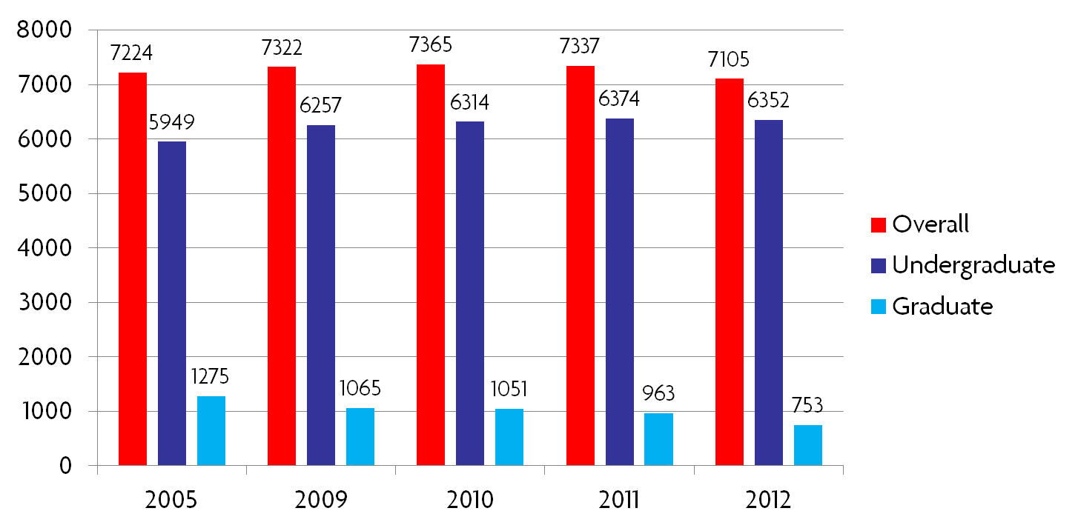
Enrollment

Slide 10
Academic Department Data

Slide 11
Retention, Completion and the Student Experience
Look at
  retention and graduation
  patterns of cohorts
  potential factors based on theory and what emerges from data
    Integration,Involvement,Effort,Motivation
Data Sources
  Institutional/SUNY, College Student Inventory, NSSE and SOS

Slide 12
3rd Semester Retention Snapshot

Slide 13
3rd Semester Retention Race/Ethnicity

Slide 14
3rd-7th Semester Retention for 2007 Cohort

Slide 15
Degree Completion Rates

Slide 16
Degree Completion Race/Ethnicity

Slide 17
Degree Completion by Gender

Slide 18
Transfer Time to Degree
Mean Years for 2011-12 Graduates
 | Overall | Male | Female
Overall | 2.78 | 2.81 | 2.76
White | 2.96 | 3.02 | 2.92
Black/African American | 3.18 | 3.14 | 3.25
American Indian/Alaska Native | 2.83 | 2.75 | 3.00
Hispanic/Latino | 2.89 | 2.86 | 2.93
Asian/Pacific Islander | 2 |  | 2

Slide 19
First Year Experiences and Persistence
First generation status relates to lower retention and graduation
Course Grades and Retention
  COR 101,BIO 110,CHE 121,SOC 100
Learning Community Participation
  Higher retention and graduation
  Correlation has strengthened as time has gone on

Slide 20
College Student Inventory Factors
Study habits
  willingness to make the sacrifices needed to achieve academic success
  effort, rather than interest, in intellectual matters or the desire for a degree
  Self-reported study times for first year students (SOS)
    0-5 hours 30%
    6-10 34
    11-20 28
    21-30 7
    31 or more 4

Slide 21
College Student Inventory Factors
Desire to finish college
  degree to which student values a college education, the satisfactions of college life, and the long-term benefits of graduation
  students who possess a keen interest in persisting, regardless of their prior level of achievement
Dropout proneness
  overall inclination to drop out of school before finishing a degree.

Slide 22
Student Opinion Survey
 | 2003 | 2012
Would you choose Cortland again? | 67 | 75
Plan to graduate from Cortland | 77 | 88
Academic experience exceeded my expectations | 88 | 88
Overall impression of quality of education? (high or very high) | 60 | 69
General satisfaction with this college? (very or satisfied) | 77 | 83

Slide 23
NSSE
To what extent does SUNY Cortland
 | First year | Senior
Provide support for academic success (NSSE) quite a bit or very much | 80 | 73
Encourage contact among students from different backgrounds | 67 | 50
Provide support to thrive socially | 69 | 50
Emphasize spending significant time studying/academic work | 83 | 79
Attend campus events | 78 | 72
Overall experience | 96 | 88

Slide 24
Considerations
Challenge of being on the mean
Understanding cohort patterns
  Men
  Black/African American students
  First generation students
  Lower motivation, engagement (CSI)
Student satisfaction positive across many areas
Increase use of data to inform our decision making, planning and assessment
  IRA website
  Data warehouse
From data to information to knowledge

Slide 25
Intentionality
Knowing our students
Campus priorities
Identifying student learning outcomes

Slide 26
Outreach Based on Data
CSI
Early Alert – behavioral factors
  COR/Course grades
Academic Standing
  Academic Alert

Slide 27
Beyond the First-Year
  Outreach in 3rd, 4th, and 5th semesters
  Department based initiatives
  Learning Communities
  COR 129: Enhancing the Transfer Experience
  SUNY Transfer Mobility

Slide 28
Graduation Initiatives
Major exploration and fit
4-year plans
Course planning and availability
DegreeWorks

Slide 29
Where Do We Go From Here
How do we find out more about our students?
How do we engage individuals/cohorts?
What are additional ways to measure student success?

Slide 30

John Foley
Measurement of Student Learning Outcomes

Slide 31


Biased
Reliability
Validity
Rubric
Trustworthiness
Factor Analysis
Construct
Evaluation
Objective test vs. Subjective test
Notes:
In M & E we like the toss out some words and formulas –

Slide 32
Middle States Report:
“further development of measurable learning goals at the program and course levels for all academic programs”

Slide 33

Fairness = clarity of expectations
Notes:
People like to know where they are going This helps engage and motivate the some students.
Odd thought: “Do you know where you are going to?” Diana Ross just popped into my mind.

Slide 34
Learning outcomes
Are they measurable?
Are they on the syllabus?
Are they conveyed to the student as important?
Are they connected to grading?

Slide 35

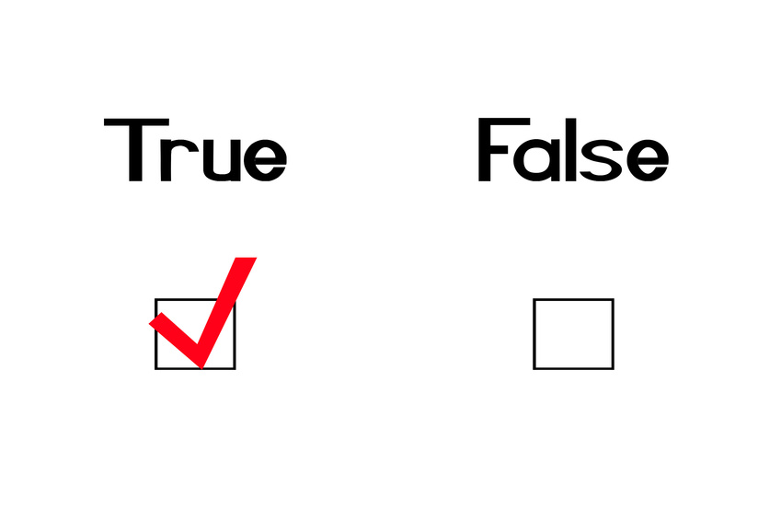

Measuring outcomes
  Rubric
  Exemplary: Foley finished under 10 minutes, stayed on topic, correctly pronounced every word and did not use an expletive.
  Target: Foley finished at 10 minutes, stayed on topic, correctly pronounced almost every word and did not use an expletive.
  Acceptable: Foley finished a little over 10 minutes, or drifted off topic, correctly pronounced most words and may have used an expletive.
  Unacceptable: Foley finished well over 10 minutes, drifted off topic, and correctly pronounced the many expletives he used.

Slide 36
Teach
Evaluate
Learn
Assess
Notes:
It is important that the information helps inform our teaching

Slide 37


Assessment Committee
Will try to focus on student learning outcomes for the next two years
  Grants
  Seminars

Slide 38
Thank you

