Slide 1
TEC Agenda and Notes
April 28, 2014
1:00 pm to 3:00 pm
Exhibition Lounge, Corey Union
Notes:
Members Present: D. Kilpatrick; L. Czirr;K. Mack; W. Buxton; C. Moriarity; K. Rombach; R. Casella; I. Jubran; L. Scott-Mack; J. Johns; E. Gravani; A. Thomas; D. Videto, J. O’Callaghan; S. Chemsak; M. Voltura; R. Janke; J. Cottone; B. Mattingly; A. Lachance; D. Farnsworth; A. Schutt; G. Peterson; R. Grantham; B. Klein; J. Mosher, C. Widdall

Slide 2
DATA DISCUSSION
Tutorial on entering aggregated program data into the 5 unit-wide assessment rubrics- Chris Widdall
Notes:
Dr. Chris Widdall delivered a review of the 5 Unit-wide Assessment Rubrics and advised the council on how data should/can be entered into the rubric area of TaskStream. Chris reminded council members that all of the unit-wide assessment rubrics can be located in the unit dispositions rubric submission area of the TaskStream platform and can be accessed in a new DRF in the platform created to collect all of the information from assessments in all of the education programs. She also advised coordinators and others responsible for entering these data that the data can be run by individual programs or for the unit as a whole.
A concern over optional elements of the rubrics was brought up by Amy Schutt and Gigi Peterson who felt that it was difficult to assign a value to the optional elements as they were not evaluated during the clinical field experience. Chris explained how the optional elements were added and agreed to add another descriptor of N/A to each element that is considered optional so that these same problems will not be experienced in future.

Slide 3
CECE Disposition Assessments for the Cortland Education UNIT As part of our Accreditation process at SUNY Cortland we are required as an Education Unit to collect certain data on teacher candidates’ dispositions and impact on p-12 learning. This is a Unit Assessment so a new DRF in Taskstream has been created to collect all the information in all education programs. Data can be run by program and by the Unit. Questions email: chris.widdall@cortland.edu
Log into Taskstream and click on the HOUSE tab to be sure you are on the home page. See black arrow.
Be sure you are in Evaluator Tab Mode. See the red arrow.
From the Blue Arrow you can decide if you want Image/Box view or List View. In either view find the DRF that says Disposition Assessments.
Example : See Orange Arrow this is the CECE Disposition Assessment area. Click on the link.
After you click on the link please leave the check marks in the default positions, but be sure to check the box at the bottom of the page that says Include Inactive or (expired) subscribers. Then click the CONTINUE tab.
You will now see a page with all the teacher candidates in our program in alphabetical order by last name. Scroll down to find your candidates’ names and do the Disposition Review 2 and Candidate Impact on P-12 Learning. (DO NOT due Review 1 – This should have been done prior to ST.)
The next screen you will see a green Evaluate/Score Work tab, click this and a new window will open with the rubric you need to complete. The Disposition (Review 2) is 17 scores and Candidate Impact is 4 scores.
Select a score level for each area with the drop boxes. If you want to put in comments for the candidate use the box that says “Comments on this criterion (optional):” If you use the “For Admin Use:” it will only be viewable by managers in the program.
You may add an overall comment if you wish, it will be seen by the candidate. Click the yellow tab “Submit Evaluation Now” Follow all these steps for each student teacher for both the Disposition Review 2 and Candidate Impact on P-12 Learning.
Only click evaluate tabs for your students. Contact Chris Widdall if you accidentally click a student’s evaluate tab that is not yours..

Slide 4
OLD BUSINESS
Update on Implementation of the new TECRC Policies (J. O’Callaghan)
Over 260 students reviewed in 14 meetings since August 2013
Transition to Onbase – old documents
Student Conduct: change in letters
Asking faculty to use syllabi to spread the word.
Implementation of new policy (approved in fall) re: disclosure of charges (1 case)
Notes:
Dr. Jerry O’callaghan conducted a review of progress with regard to implementation of the new TECRC Policies and Procedures that were adopted in October, 2013.
One way that we are hoping to inform candidates of their responsibility to report violations and charges in a timely manner is to include a statement on the course syllabi. Several members thought it important to have consistency in this statement across all programs . Dr. Ronnie Casella indicated that he has written a statement for use on all syllabi and he also indicated that he will distribute it electronically to all teacher education programs for use on the course syllabi.
Jerry also indicated that the committee is in the process of developing a new brochure outlining the policies and procedures of the TECRC. Discussion ensued with regard to when candidates would received the brochure and how we can defend against the canididate claiming ignorance of the P & P, particularly where disclosure of violations and charges are concerned. The general consensus is that, in addition to regular communication channels, candidates should receive the brochure during orientation (particularly transfer orientation) and having candidates sign that they have read and understood the P&P at the time of admission to a teacher education program. It was also suggested that it may be worthwhil to have candidates take a 2 or 3 question quiz on the policy and procedure in addition to signing that they were informed. Another suggestion was that we might want to ask some student group to produce a video containing role play situations for broadcast in COR 101 and at other venues as a means of raising candidate awareness of disclosure policies.

Slide 5
TECRC Policies Cont’d
Decisions on our procedure made in January:
revision of language in our standard letters;
Reliance on email as primary means to inform students of decisions;
Advertising of student obligation to disclose (student newspaper and electronic bulletin)
Summer/fall projects
Annual meeting with coordinators
Internal discussion on how to grab student attention, short of delayed field work
Update web page and new brochure to emphasize new policy.
Notes:
Dr. O’Callaghan indicated that much improvement has already been made with regard to implementation of the new P&P but also indicated that there is still work that needs to be completed. He highlighted 3 activities/initiatives that will be undertaken over the summer and into the Fall 2014 semester.

Slide 6
OLD BUSINESS
Revisions to the TEC Bylaws (J. Cottone & Committee)
TEC Bylaws Outline
Bylaws Side by Side Comparison
Membership Models
Notes:
Dr. John Cottone provided a review of modifications to the TEC Bylaws that have been discussed at previous TEC Meetings from the last two semesters (Fall 2013 and Spring 2014).
Teacher Education Council By-Laws (For Information Purposes Only)
I. Preamble
II. Role and Function:
III. TEC Chair and Function of Chair and Unit Head for Teacher Education Programs
IV. Membership
Teacher Education Program Representatives (Voting)
Ex officio Representatives (Non-voting)
Designees
SUNY Cortland Regional Education Consortium (SUNY-REC)
V. Registration of Membership
VI. Voting
VII. Meetings and Agendas
VIII. Committees
Steering Committee
Teacher Education Candidate Review Committee (TECRC)
D. Ad Hoc Committees
IX. Ratification and Amendment
April 22, 2014
Dr. Cottone also presented a new model for membership, (see inserted slide).
Discussion centered on reduction of the voting membership to facilitate easier conversation and decision-making within the council. Modifications were
A motion was made by Lynn Couturier and seconded by Regina Grantham to put the proposed model with modifications (in red) to an immediate vote. The motion carried and this item will be put to an immediate e-ballot.

Slide 7
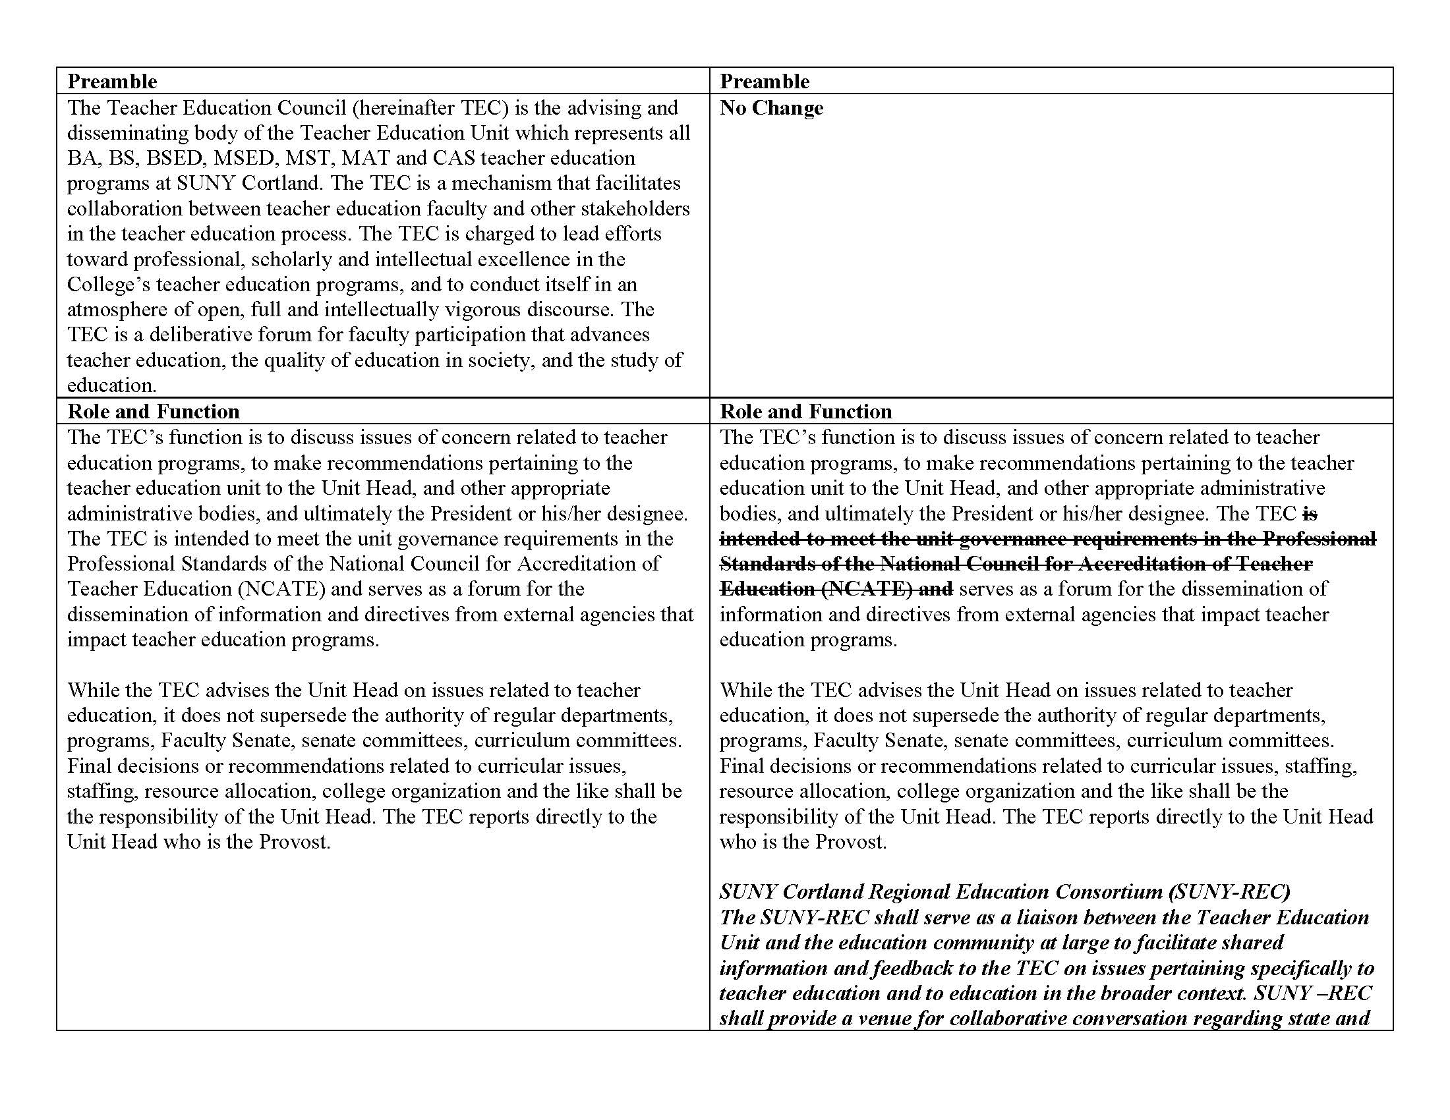

Slide 8
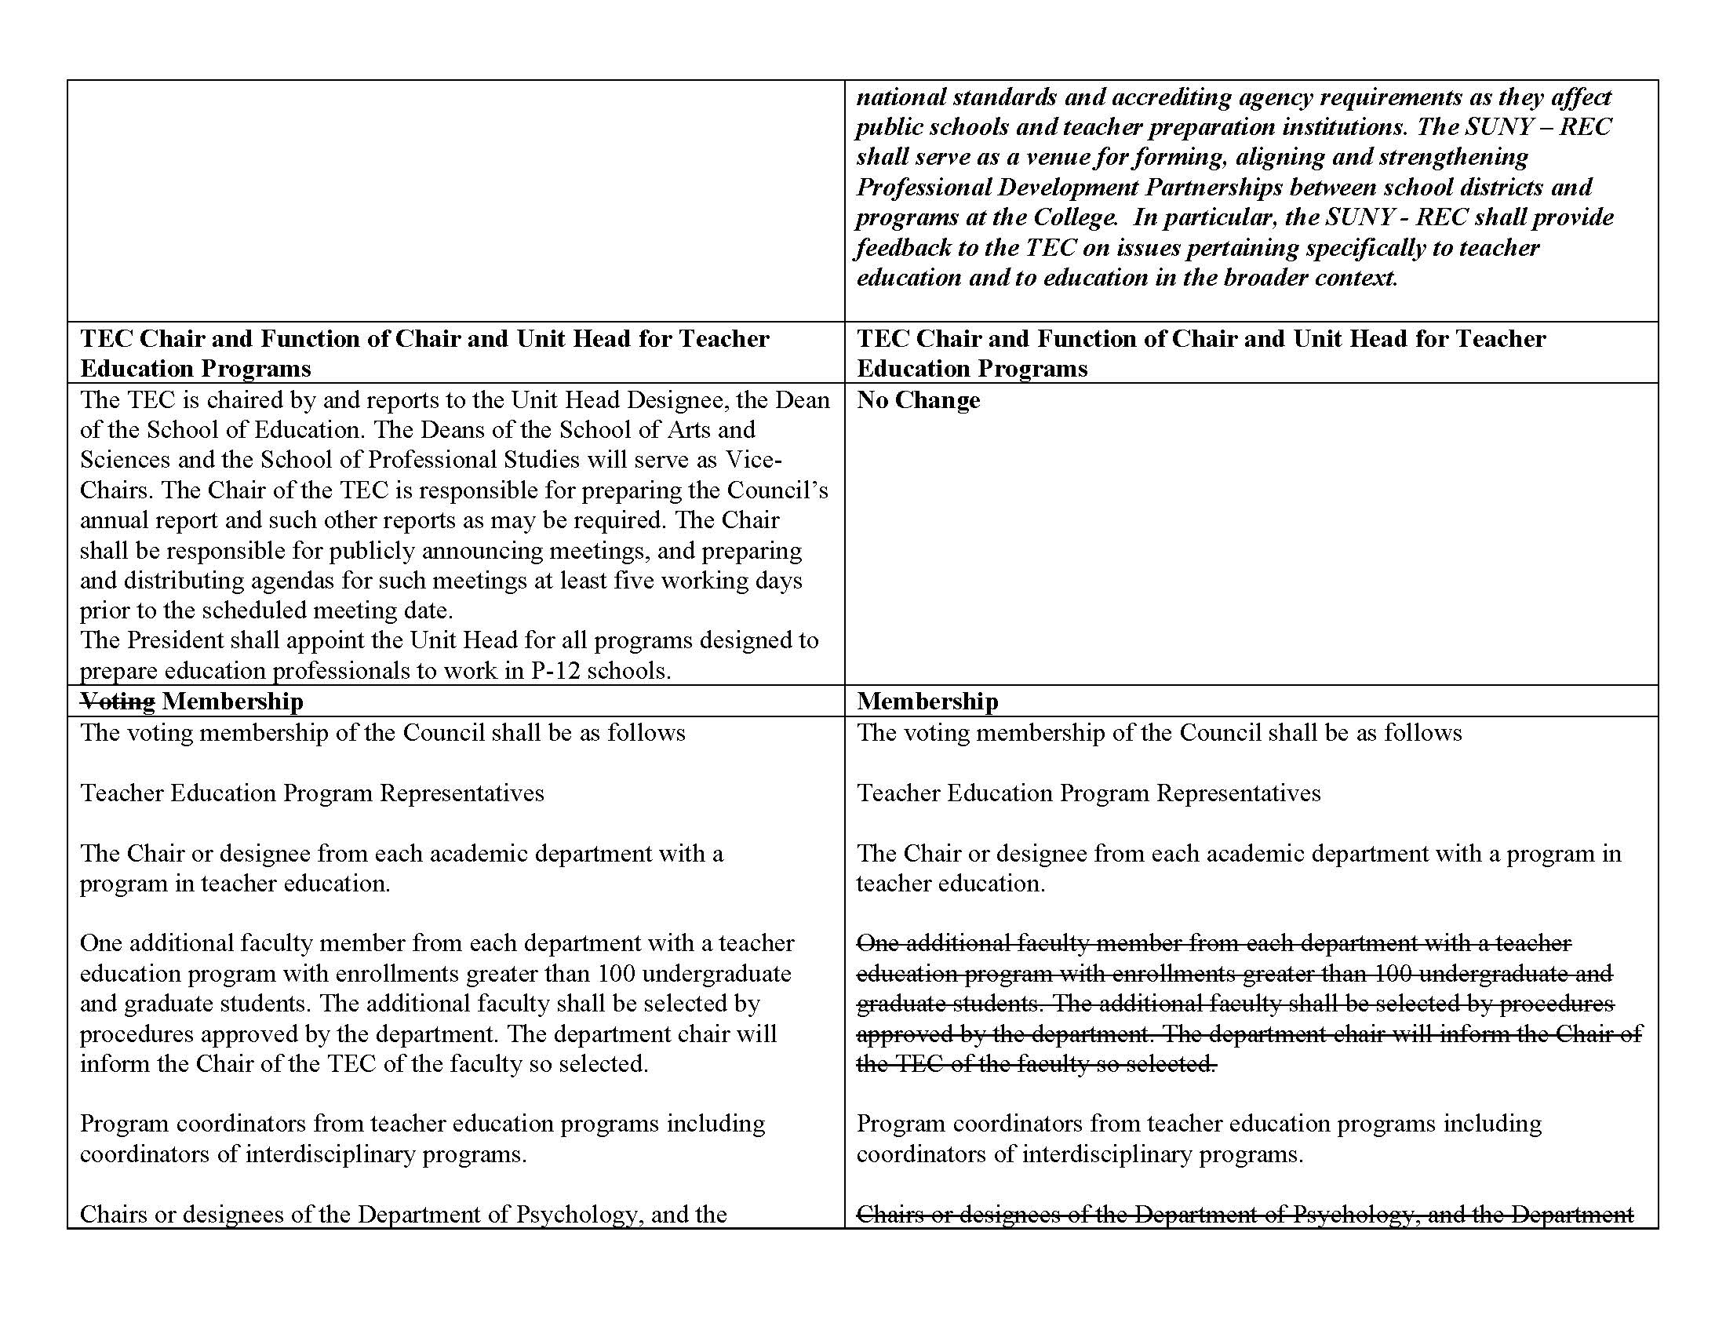
Notes:
A discussion with regard to voting members resulted in two changes in the proposed language of the section: The Chair or designee from academic departments housing a teacher education program, and Program coordinators from teacher education programs. These changes in the proposed language will be reflected in the amended bylaws if the e-ballot on the issue carries.

Slide 9
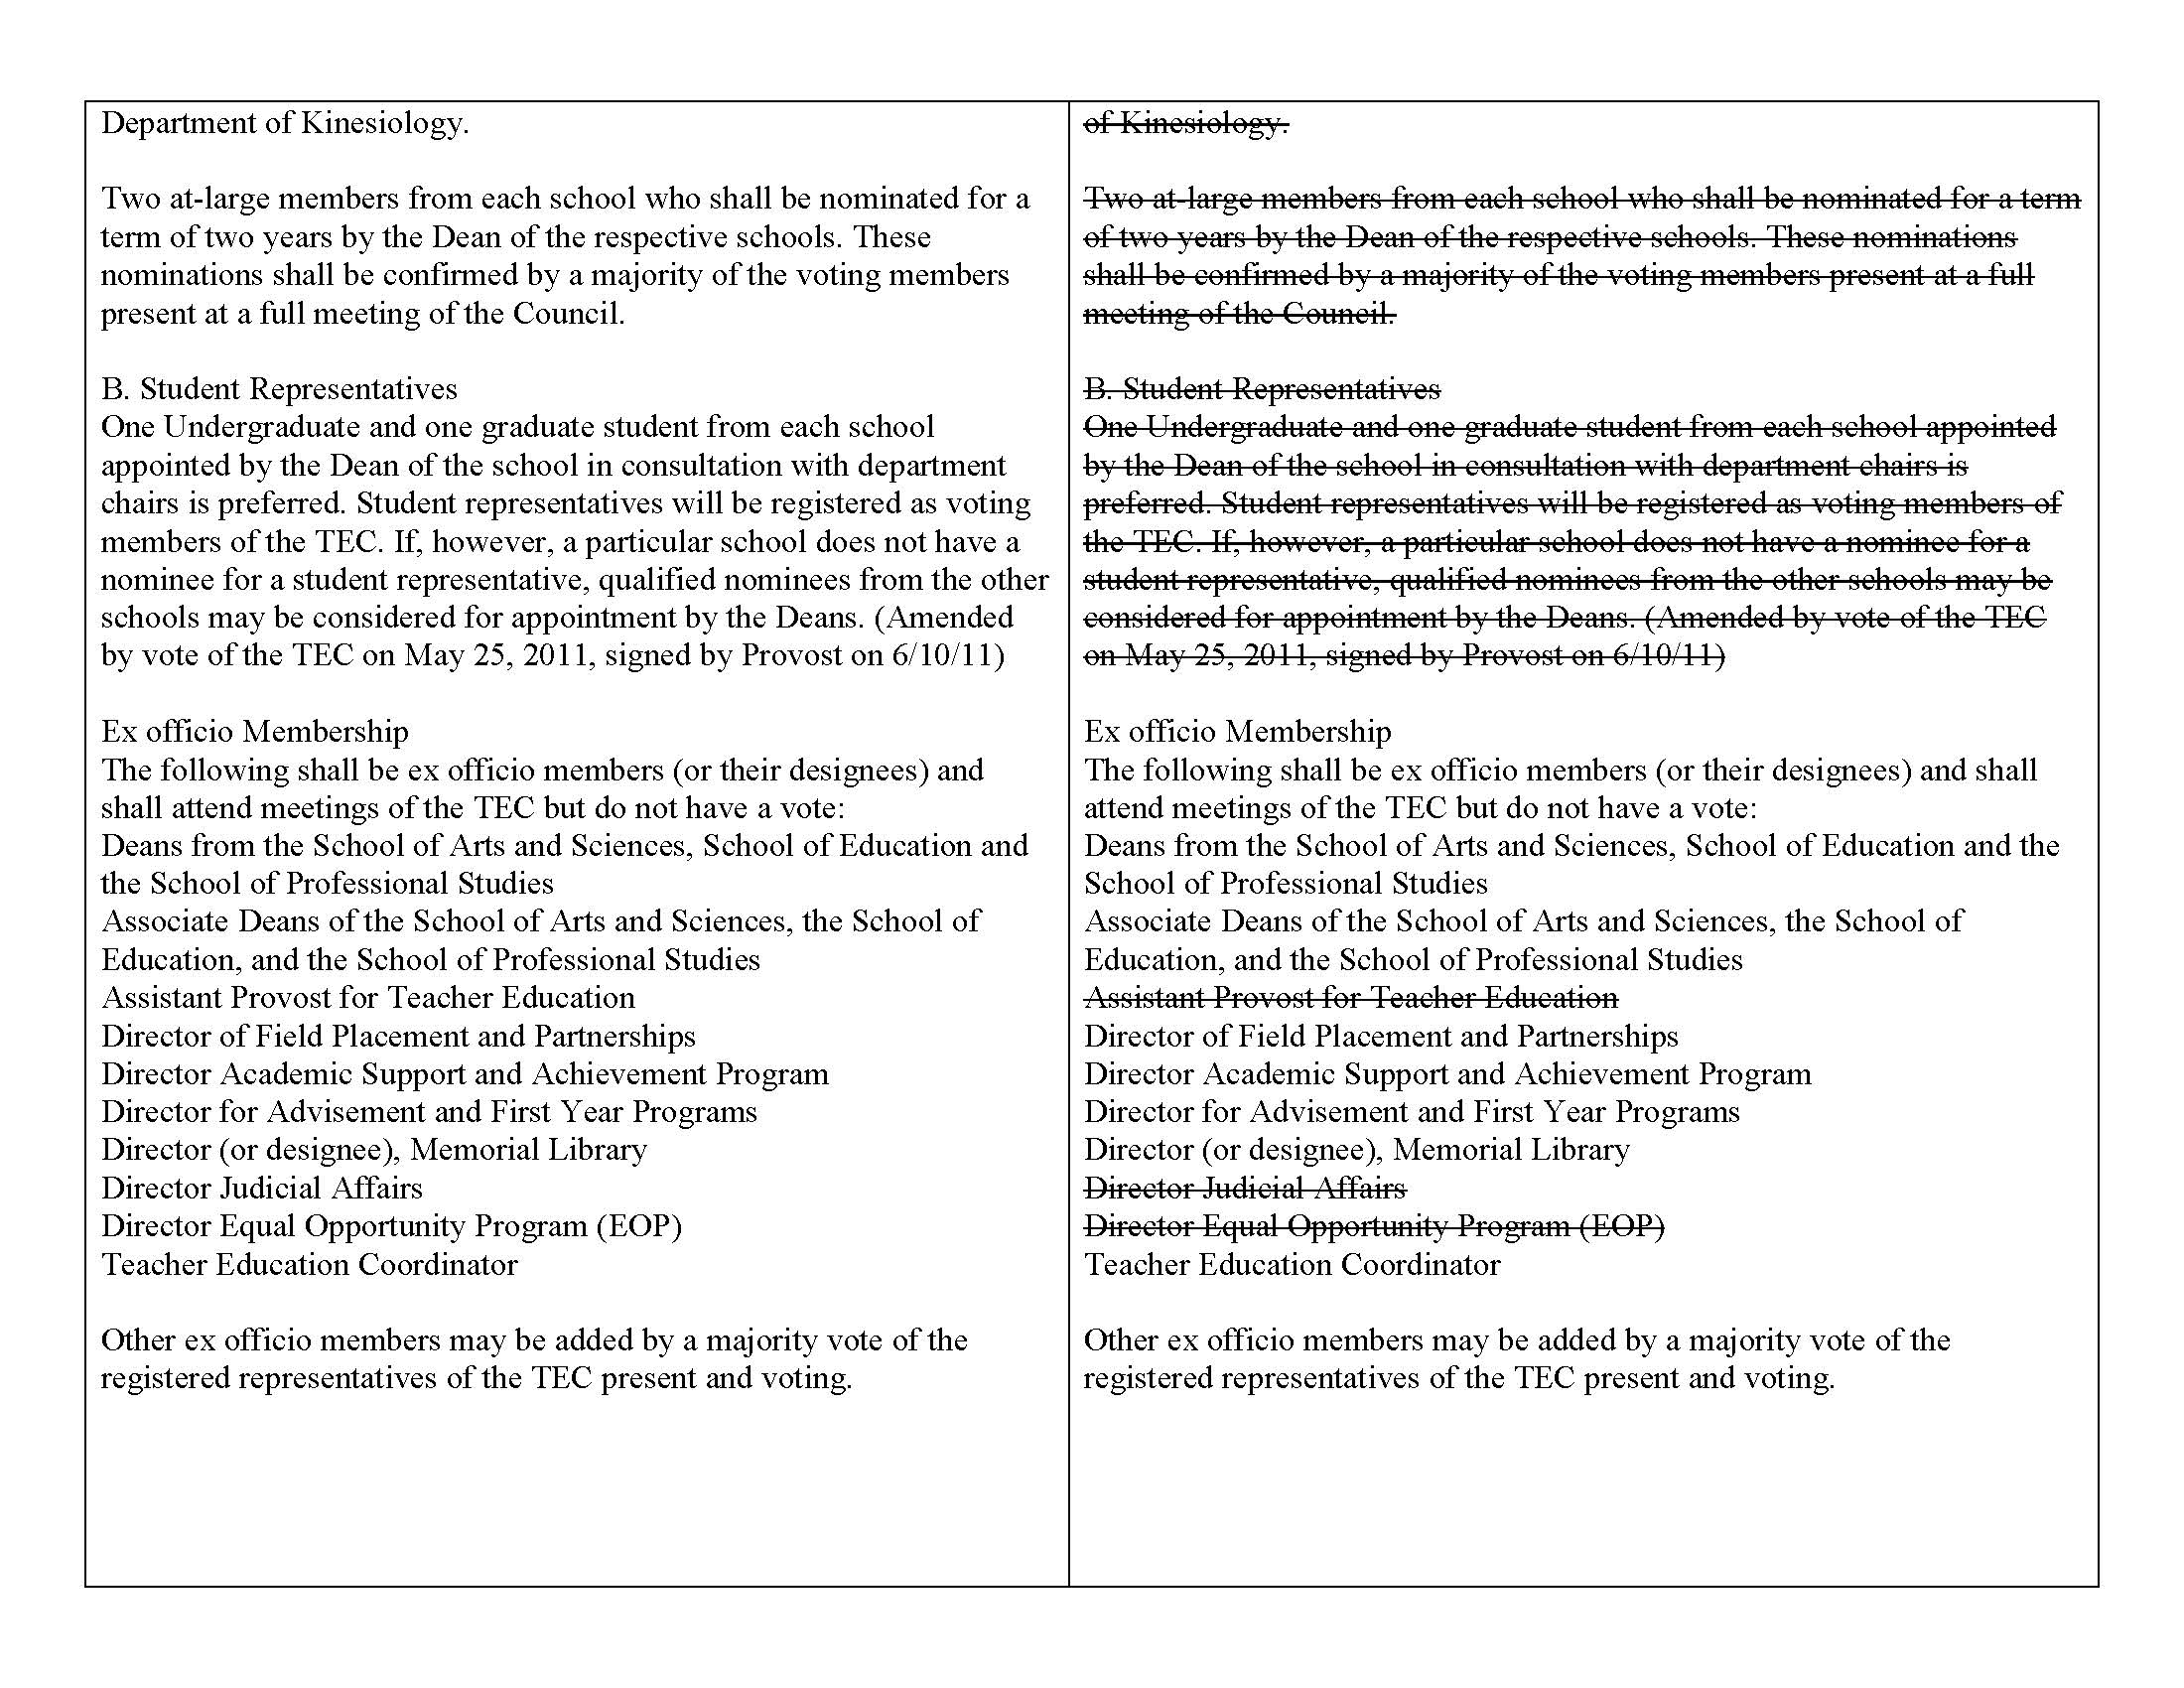
Notes:
Discussion by the full council resulted in the removal of ex-officio members from the Department of Kinesiology and the addition of the Director of the Office of Institutional Research and Assessment. All changes will be reflected in the e-ballot to adopt these modifications and amendments.

Slide 10
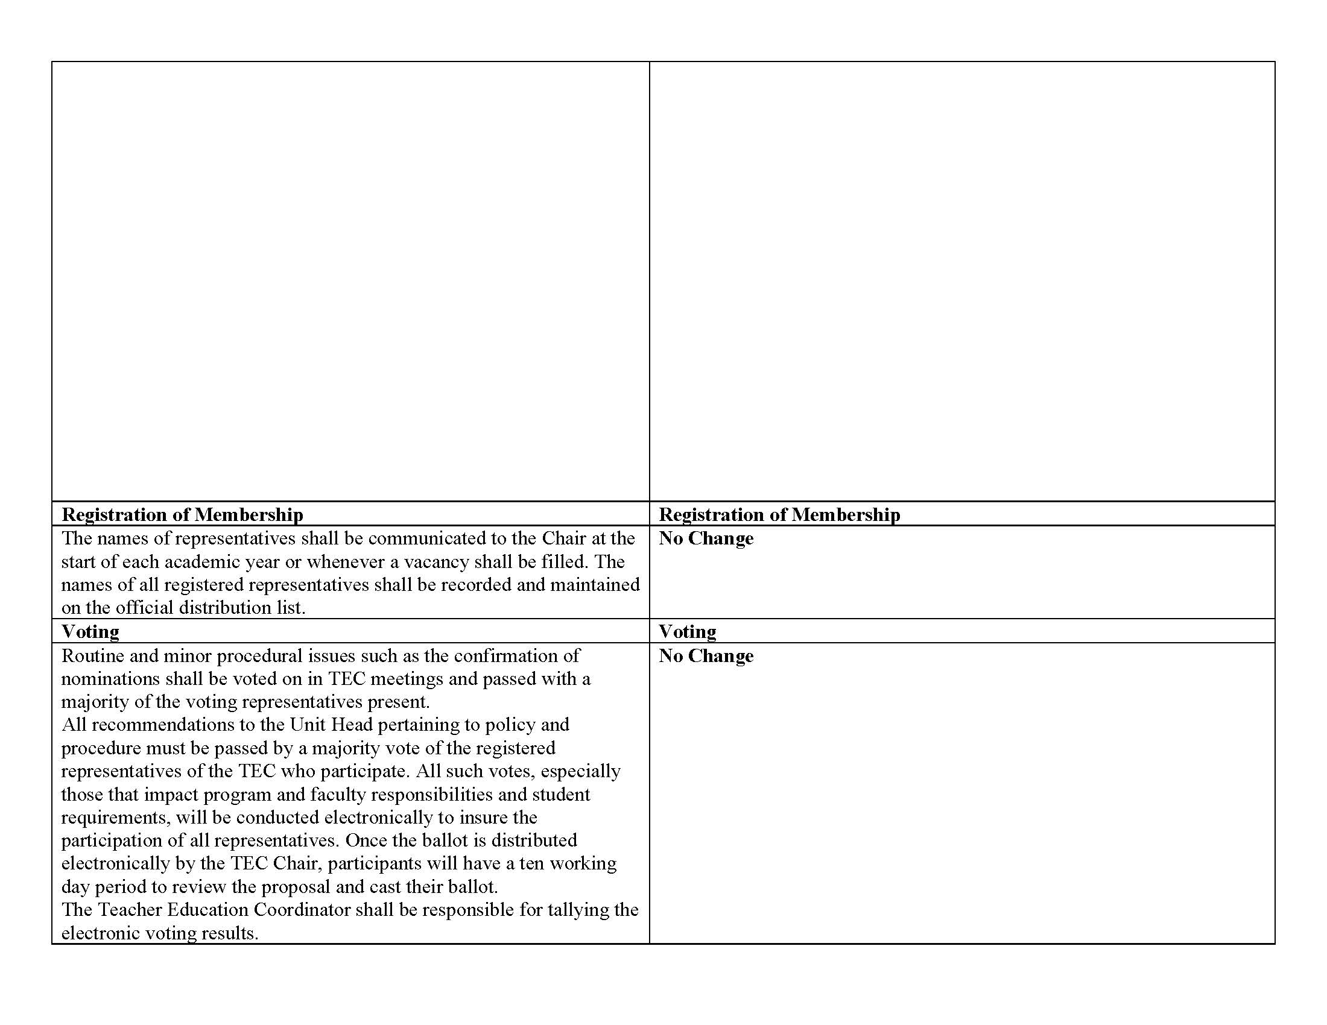

Slide 11
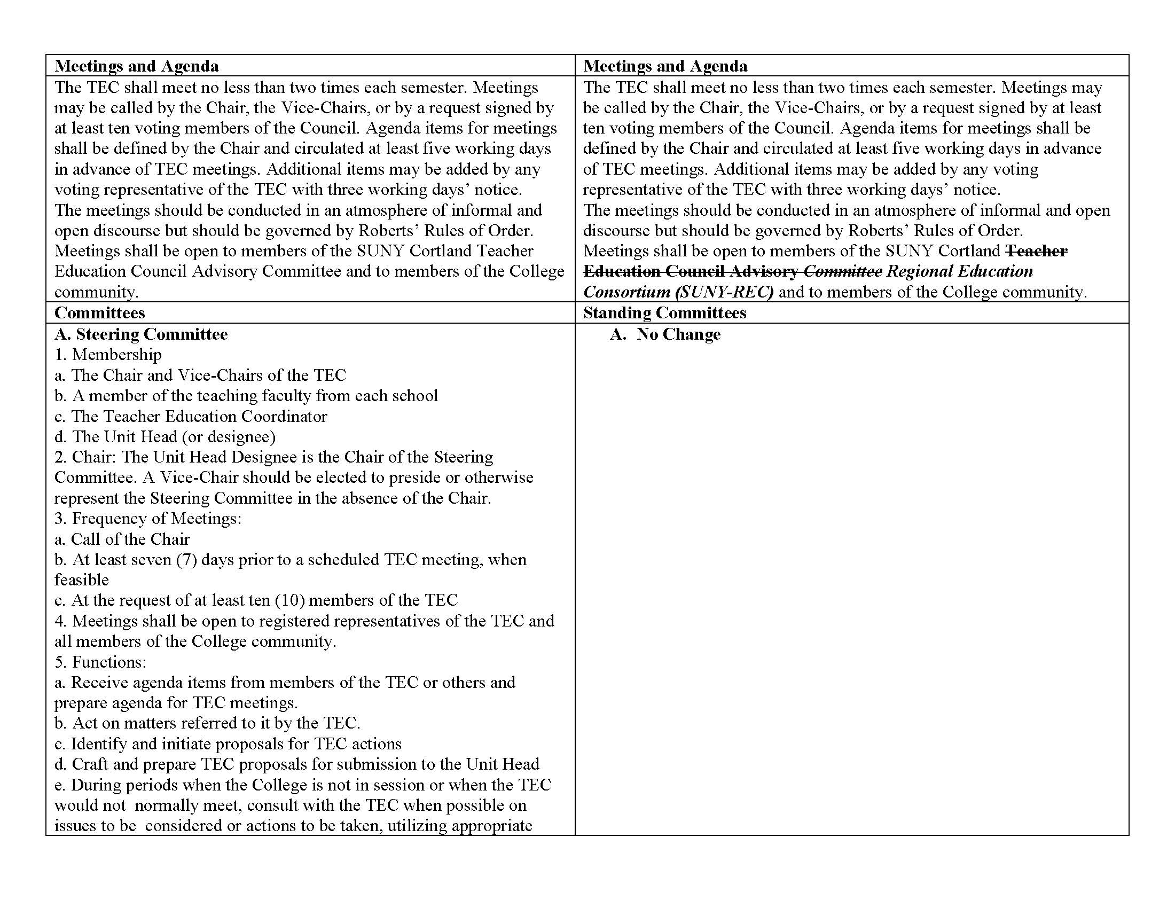

Slide 13
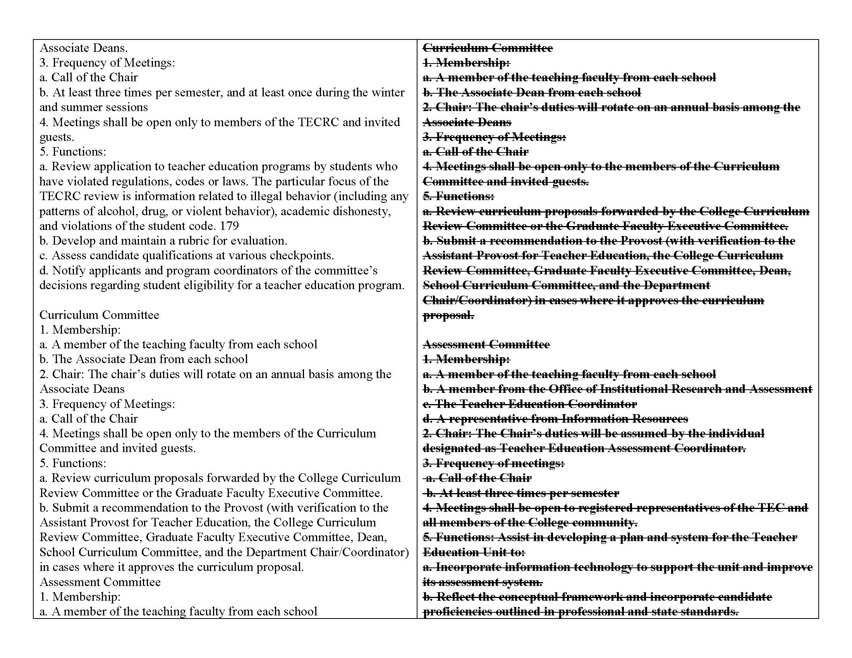

Slide 14
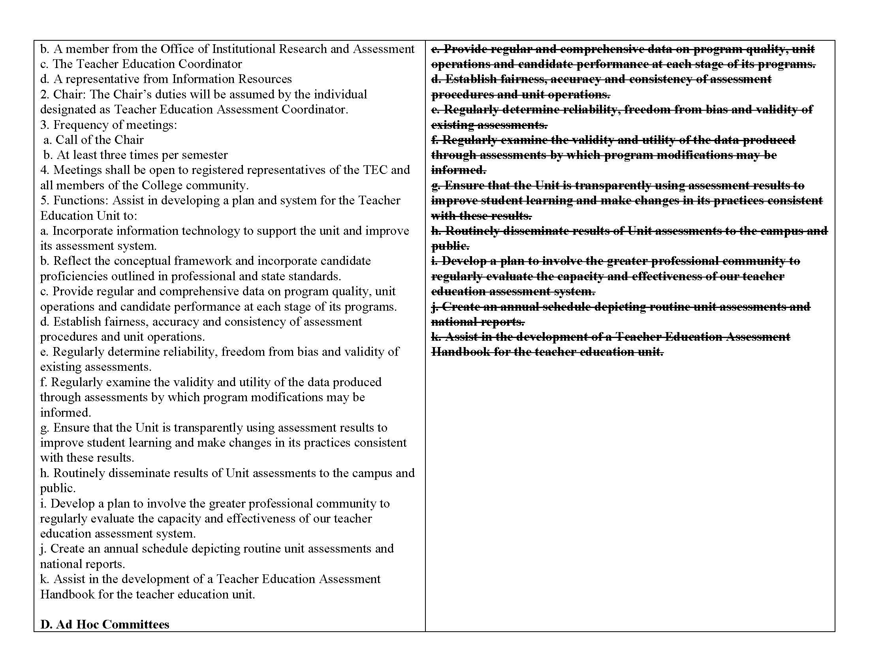

Slide 15
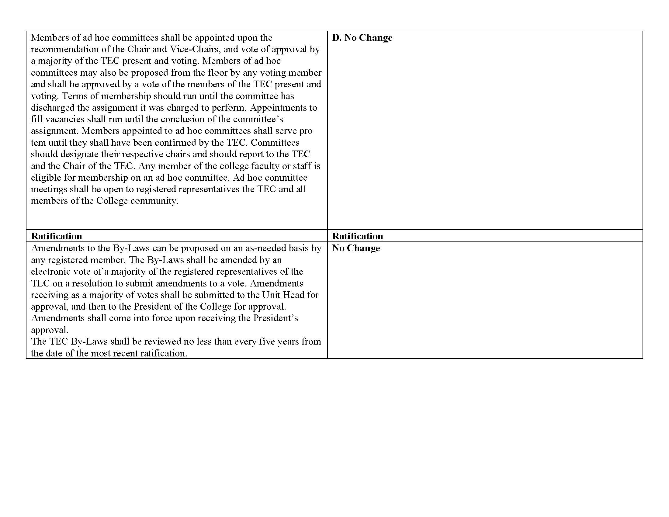

Slide 16
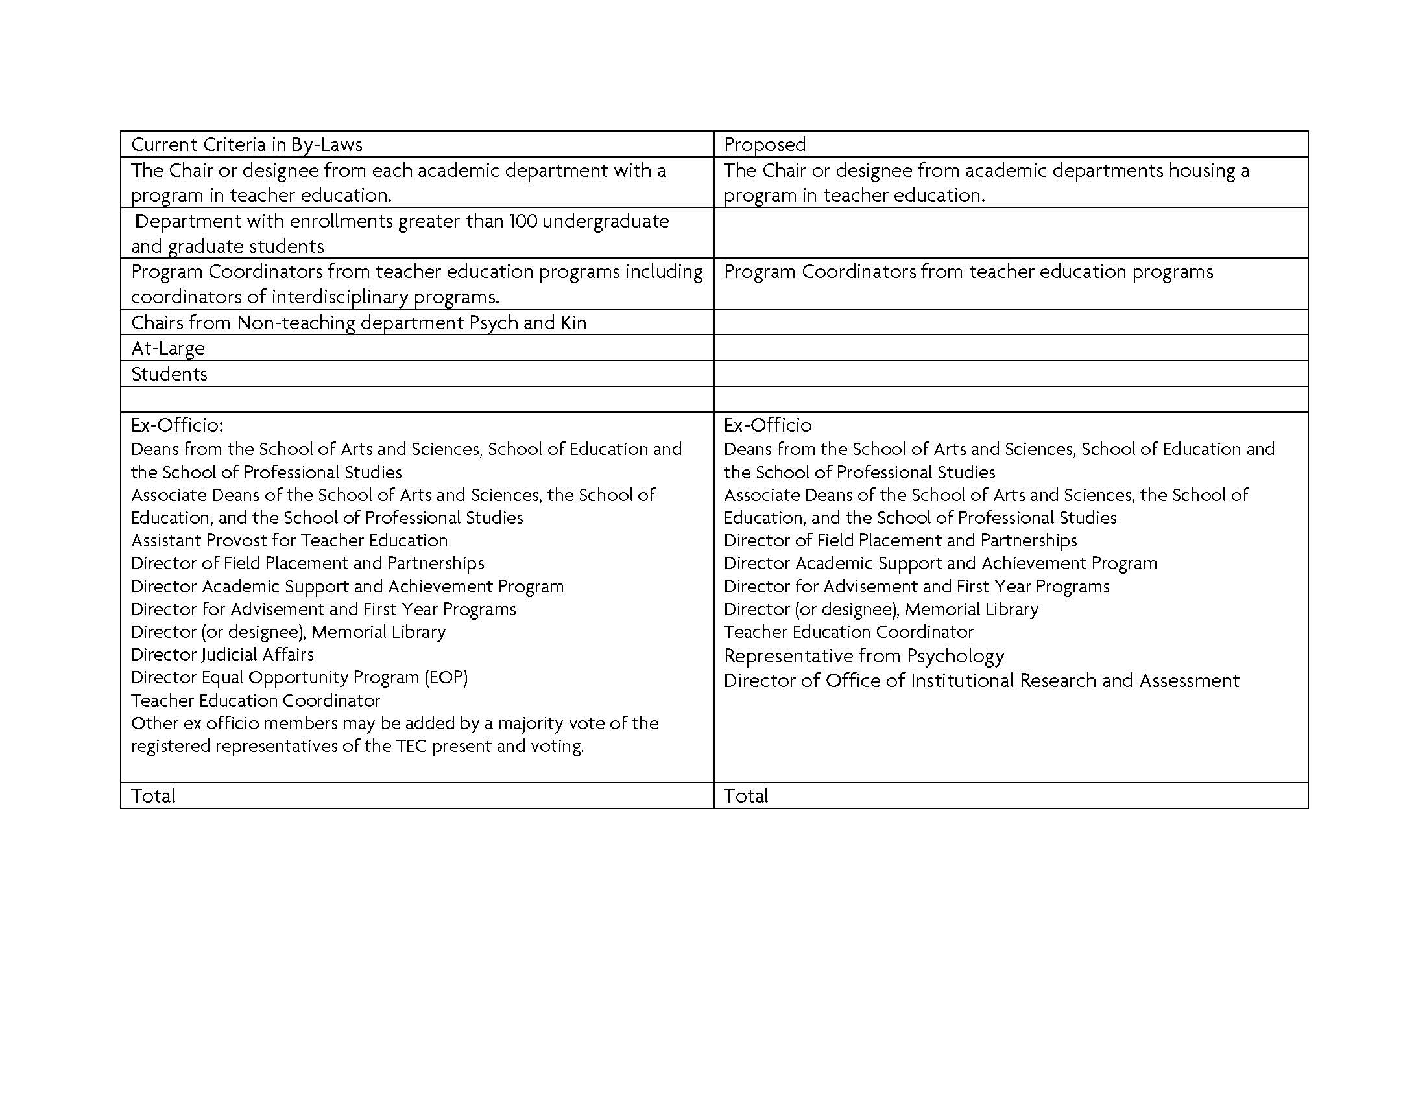

Slide 17
TEC Bylaws Revisions
Current
Proposed
Preamble
Role and Function
TEC Chair and Function of the Chair and Unit Head for TEC
Registration of Membership
Voting Membership
Meeting and Agenda
Committees
Ratification
No Revision
Revision
No Revision
No Revision
Pending Revision
Revision
Revision
No Revision
Notes:
Dr. Cottone prepared a side-by-side comparison of old to new bylaws with all changes noted. (See inserted slides)
A motion was made by Donna Videto and Seconded by Chris Widdall to put the proposed changes/modifications to the TEC Bylaws of 2009 to an immediate vote. The motion carried. An e-ballot will be prepared for immediate publication to accept all changes to the TEC By-laws, as presented.

Slide 18
NEW BUSINESS
Discussion: Should required NYSED workshops (CARR, SAVE, and DASA) be prerequisites for student teaching for all programs? (A. Lachance)
Notes:
Dr. Lachance presented her rationale for moving to make the required Teacher Education Workshops a pre-requisite for student teaching and opened the floor to discussion of the issue. The general consensus was that this was the preferred method to ensure that the candidates from all programs have completed this requirement. Dr. O’Callaghan indicated that he believed that this was already a requirement in the student teaching handbook. It was also decided that if we agree to making this a requirement across the board there will be no requirement for us to put this before the college curriculum committtee.
A motion was made by Donna Videto with a second by Chris Widdall to put the issue to an electronic vote. Motion Carried.

Slide 19
New Business
SUNY Teacher Certification Consortium Conference – TCCC (D. Farnsworth & L. Scott-Mack)
We meet twice a year: Fall and Spring
Two Days: devoted to a full day with SUNY and one day with SED to discuss issues of importance related to changes in teacher certification processes and requirements
Reps are: Dennis Farnsworth, John Shirley, Lee Scott-Mack, and Annie Wilcox

Slide 20
TCC Updates Continued
Typical topics are:
certification review and Individual Evaluation pathways (expiring on 5/1, no new apps for B-2, 1-6, or 5-9 Generalist, ELA 5-9 and 7-12 (high surplus), and both literacy certs are no longer available under this option.
CST Rollout timelines- Group II will be out in September of 2014. The only title that will apply here is Students with Disabilities.
edTPA: TEACH will soon be updated to reflect pass/fail for edTPA Scores. Other scores are already there including the EAS. Guidance with regard to certification based on first certificate
SBL Exams: Until the end of June 2014 candidates seeking this cert will be allowed to mix and match from the old and new exams. In other words a candidate could take Part 1 of the old exam and Part 2 of the new exam, all of the old exam or all of the new exam.

Slide 21
Other Updates
edTPA Updates:
State-wide pass rate is 80% (900 students submitting)
SUNY Cortland pass rate is 76% with 50 students submitting.
36% of 50 students scoring at Mastery Level
Scores available to programs on Taskstream
Three retakes – none successful
Other NYSTCE Updates
Students reporting difficulty with both EAS and ALST
Some passing edTPA and not the other tests
Pass rates through the end of the semester will be calculated by graduation.

Slide 22
Other Updates
AACTE alert regarding proposals at the federal level to hold teacher preparation programs accountable including:
“…establishing a nationwide rating system of preparation programs that would rely on graduates' value-added data as the primary factor in determining quality. Under this scheme, a program's rating would also determine student eligibility for federal financial aid in the form of TEACH grants. Another proposal, the "GREAT Act," introduced last year by Senator Michael Bennet (D-CO) and included in the Senate HELP committee's recommendation for the reauthorization of the Elementary and Secondary Education Act (ESEA), would allow the creation of principal and teacher preparation academies that are not based at institutions of higher education and that would have virtually no requirements for how preparation would be provided. These academies would award certificates that the proposal would deem to be equivalent to a master's degree, even though the academies would not be obligated to meet the same standards as higher education providers.”

